Slide 1
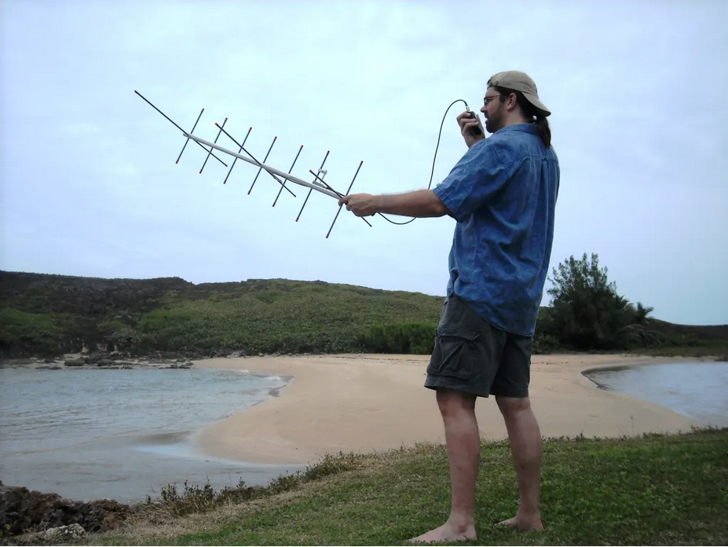

Getting Started with Amateur Radio Satellites
Talking to Space from Your Backyard
James C. Hall, WB4YDL
April 23, 2026
Notes:
No big antennas or HF rig required – just a Tech license and enthusiasm

Slide 2
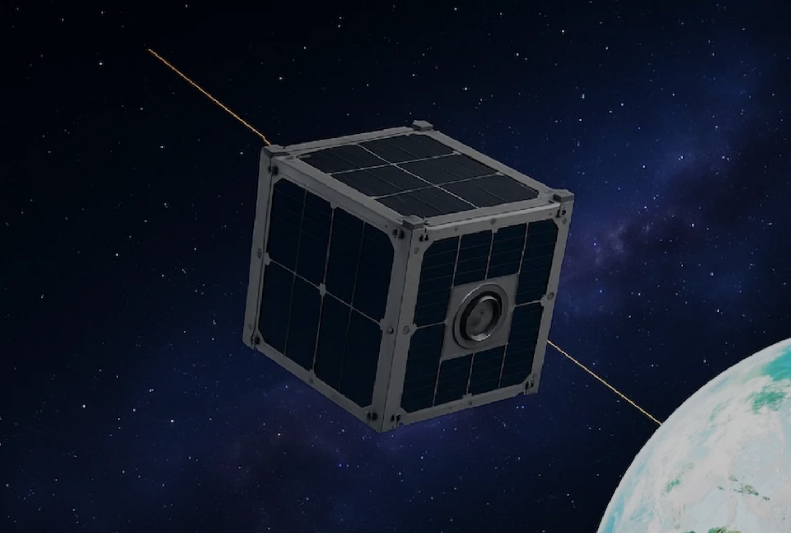
What You’ll Learn
Why satellites are awesome
How they work (basics)
Equipment (cheap & simple)
Tracking and Doppler
Step-by-step operating
Current beginner satellites
Tips, etiquette, and resources

Slide 3
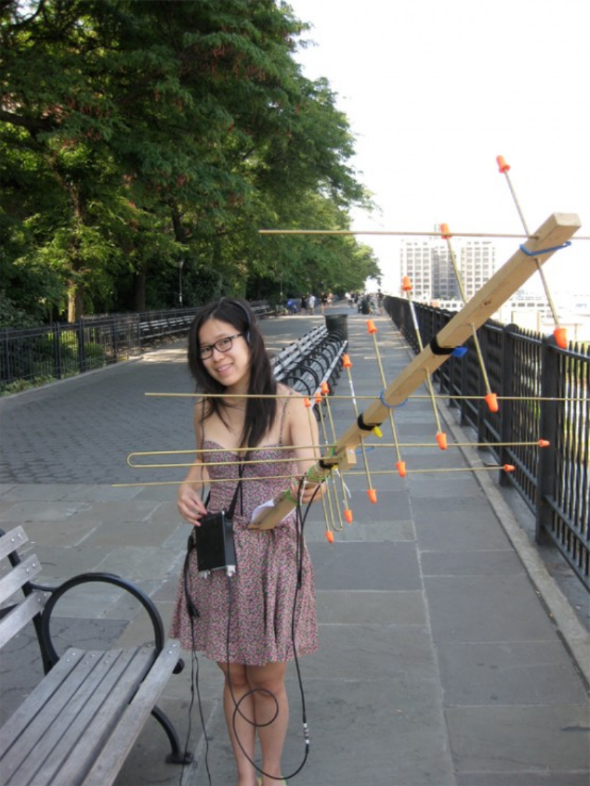
Why Work Satellites ?
Work DX on VHF/UHF with a handheld
Portable fun (POTA, Field Day, SOTA)
Science + radio + space
Great entry after getting your Tech license
Real contacts in 10-15 minutes per pass

Slide 4
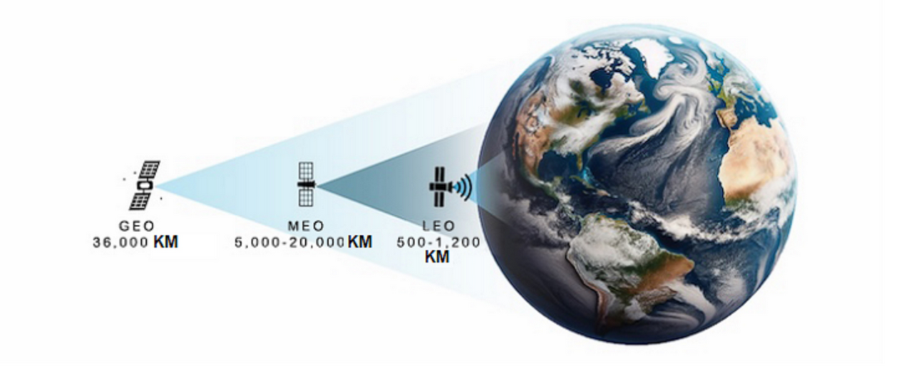
What Are Amateur Radio Satellites ?
AMSAT – Radio Amateur Satellite Corporation – builds/launches them
Low Earth Orbit (LEO) “birds” pass overhead every 90 minutes
Act like repeaters in space (FM easiest for beginners)

Slide 5
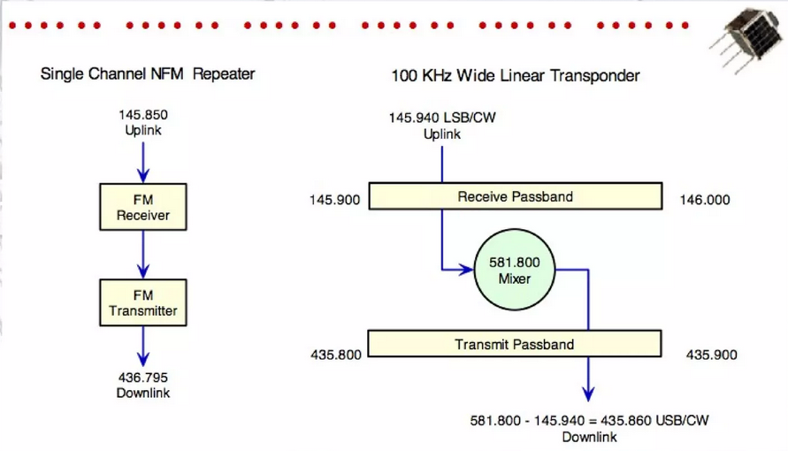
Type of Satellites
FM Repeater (easiest – like a repeater in space )
Linear Transponders (SSB/CW – next level)
Digital / packet (ISS digipeater, etc)

Slide 6
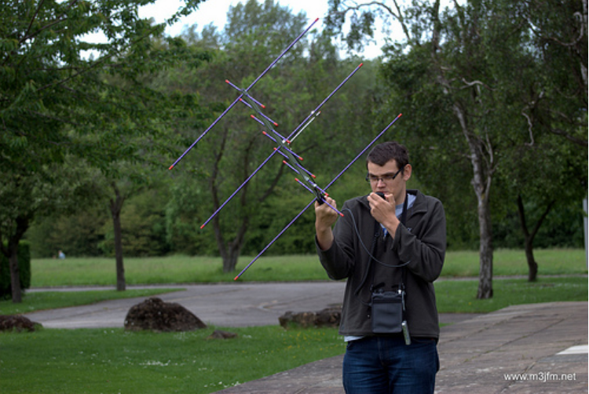
Equipment You Actually Need
Radio(s): Dual-band HT - Baofeng UV-5R or a pair UV-5R Mini (<$40) ; better Yaesu FT-65R or older Kenwood HT e.g. D7, D72 for full duplex
Antenna: Portable Yagi e.g. Arrow II or Elk ($140-200)
Optional: Smartphone app for tracking and voice recording

Slide 7
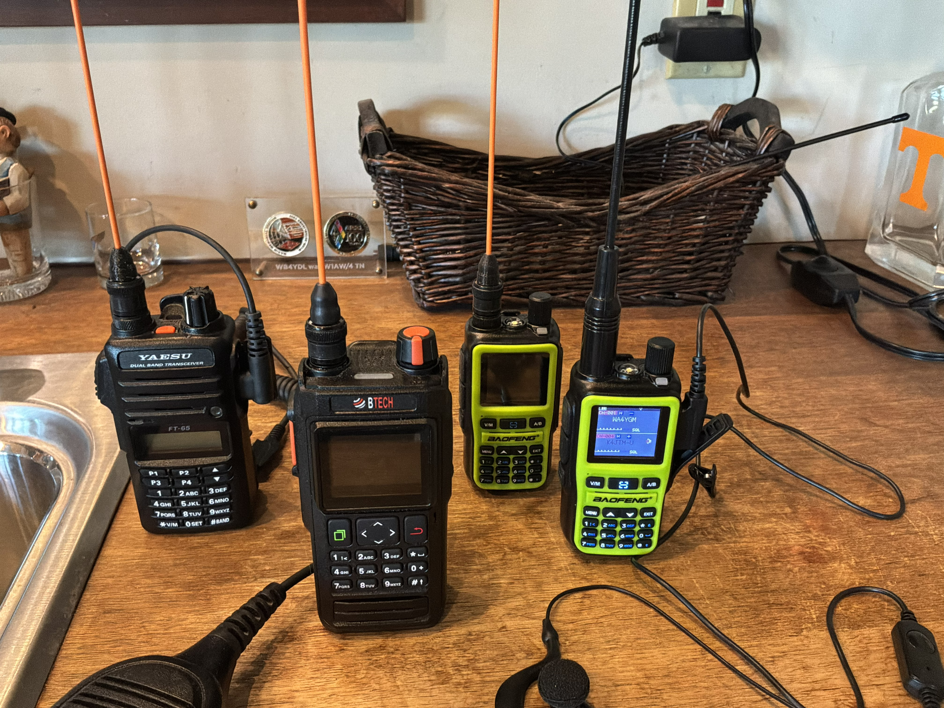

Slide 8
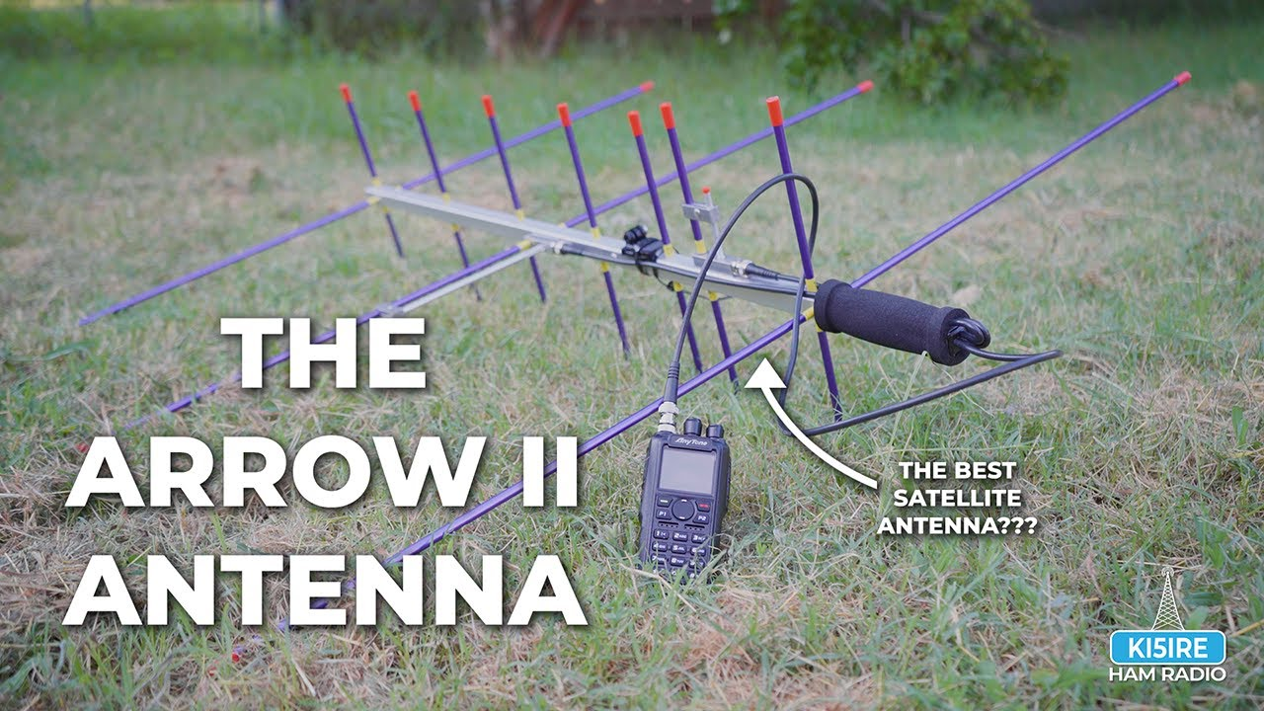

Slide 9
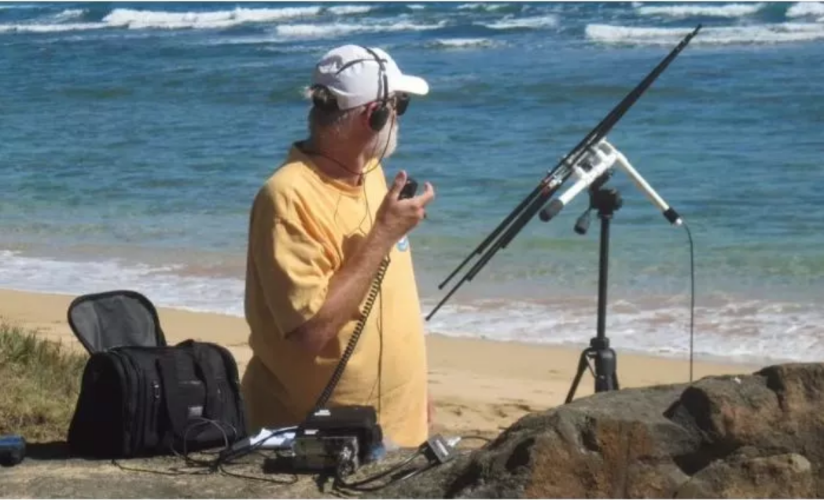

Slide 10
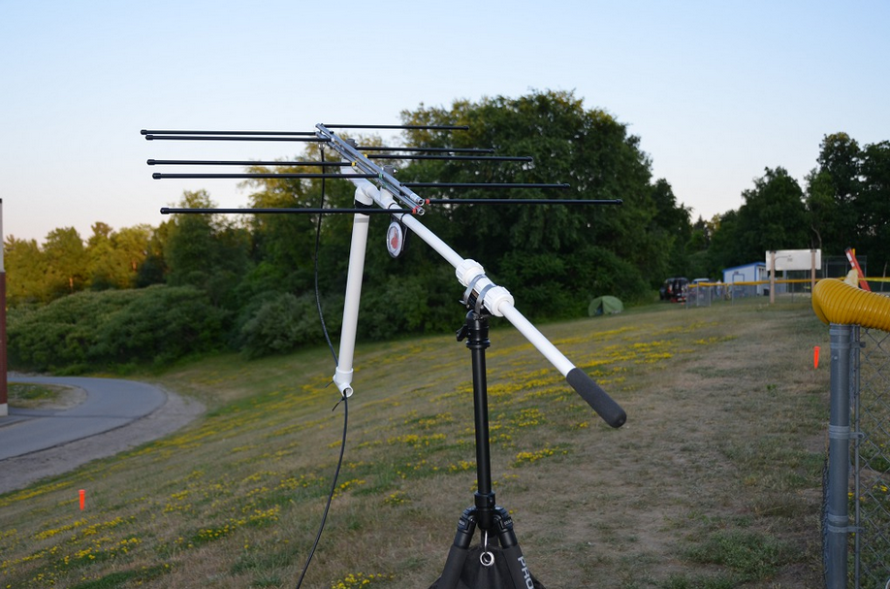

Slide 11
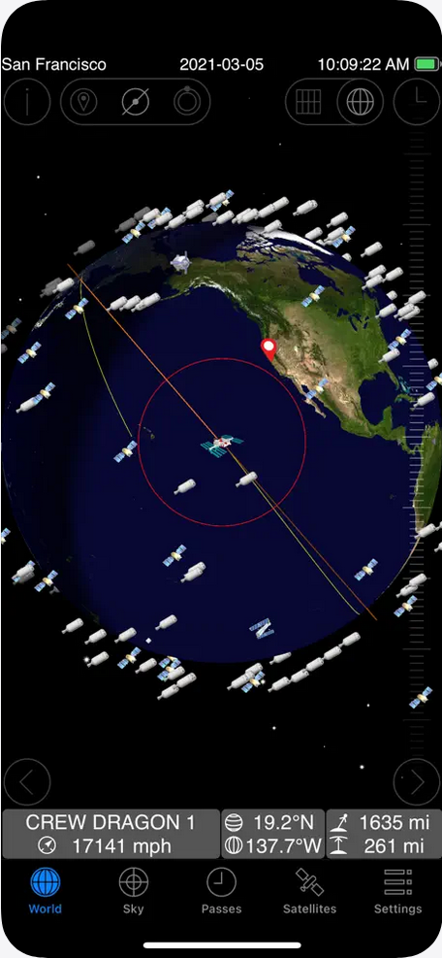
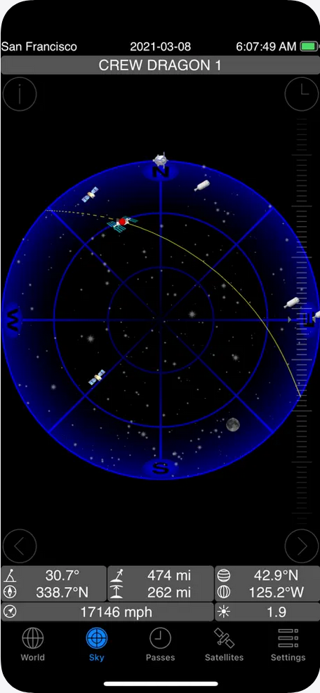
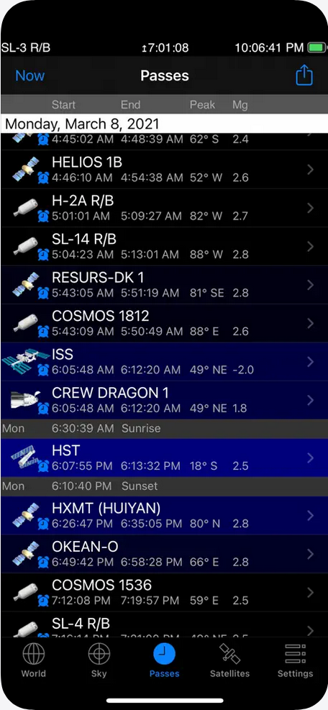
How to Find & Track Satellites
Free tools: AMSAT application, Heavens-Above.com, Orbitron, Gpredict, SkyRoof or …
Smartphone Apps: GoSatWatch (iOS), AMSATDroid, Orbitrack

Slide 12
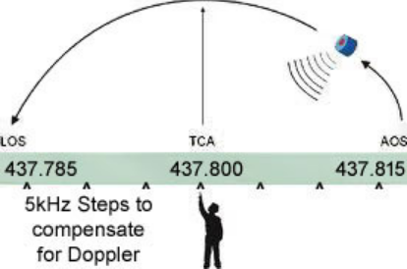
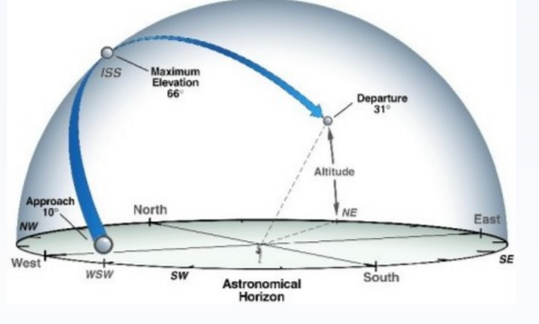
Key Terms
AOS: Acquisition of signal
TCA: Time of closest approach (Maximum elevation)
LOS: Loss of signal
Doppler shift: frequency slides up/down as satellite approaches/recedes

Slide 13
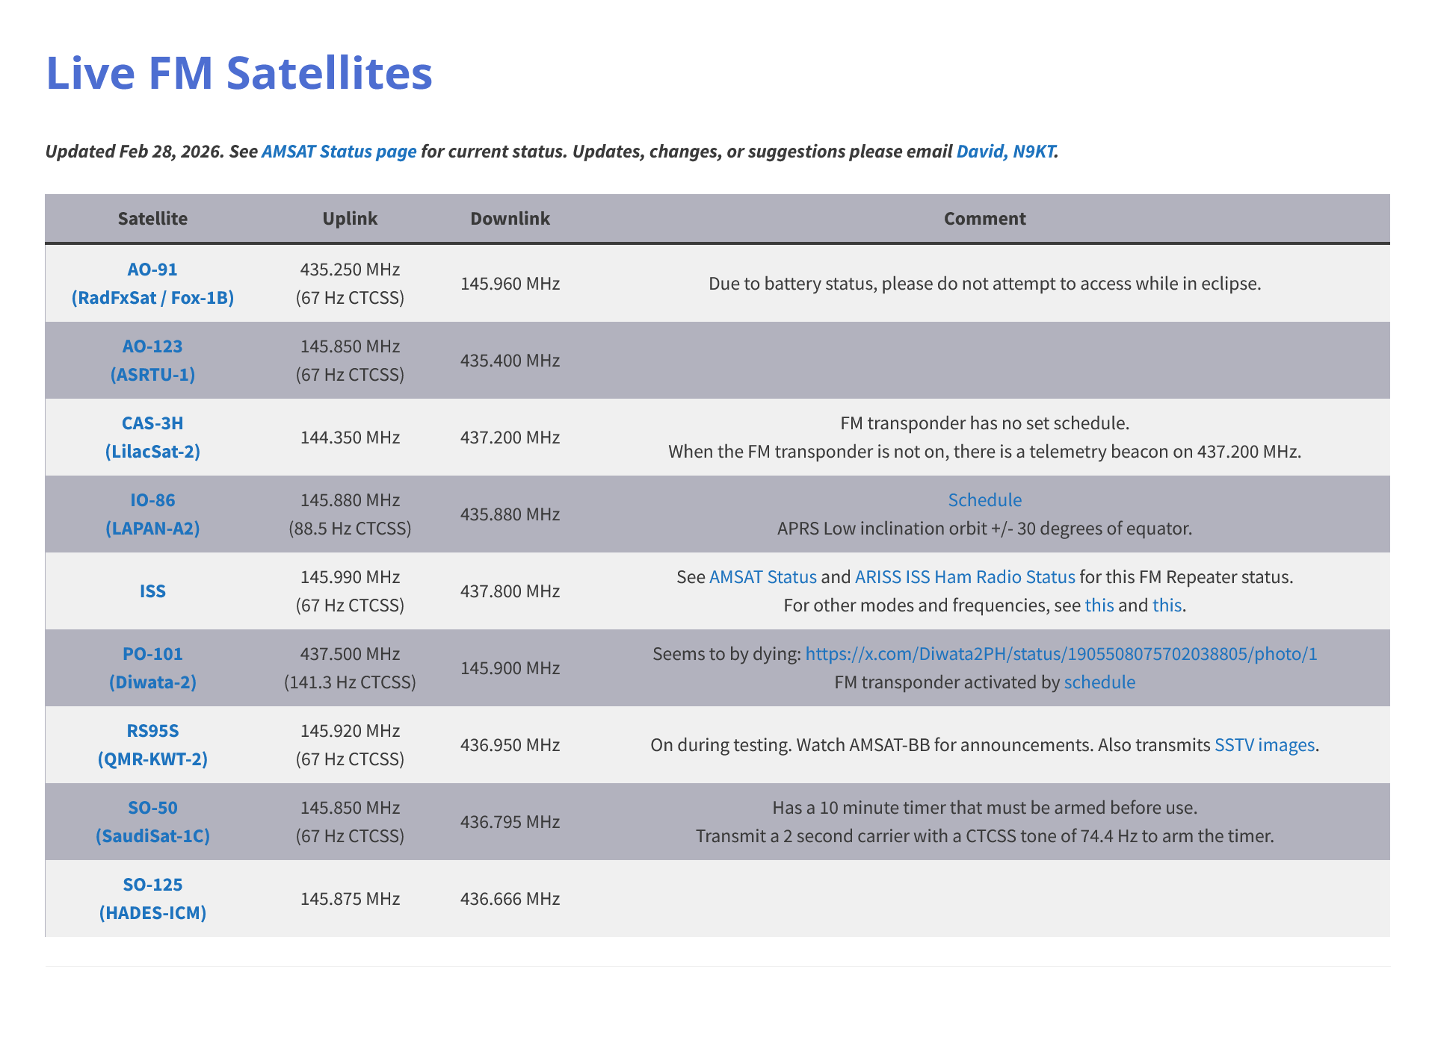
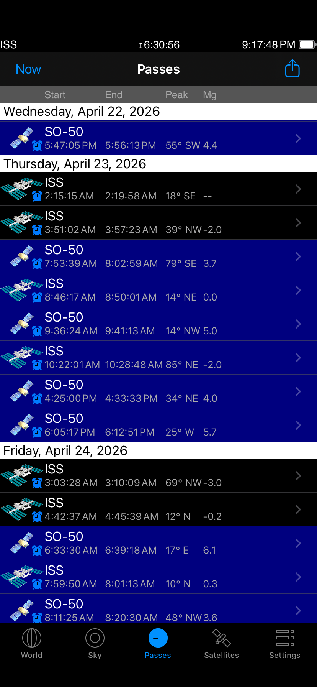
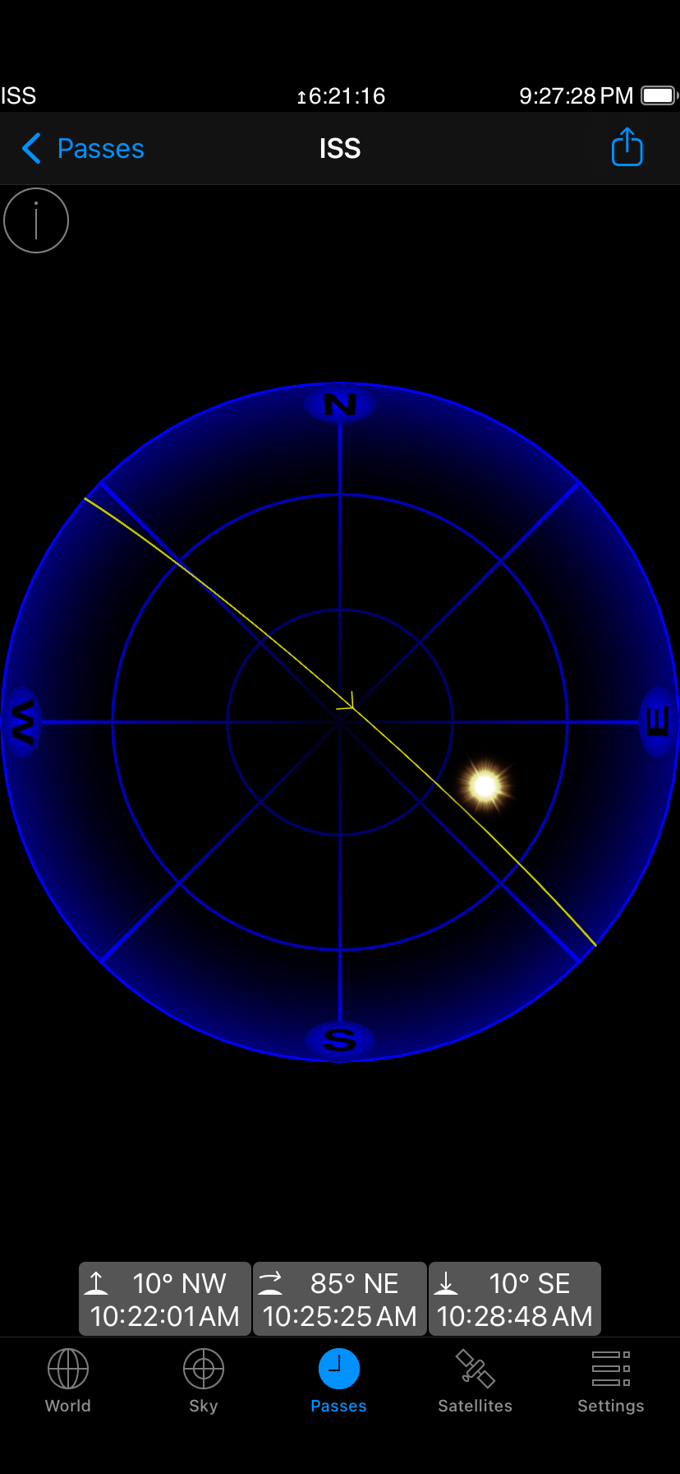
Step-by-Step Operating
Check pass prediction

Slide 14
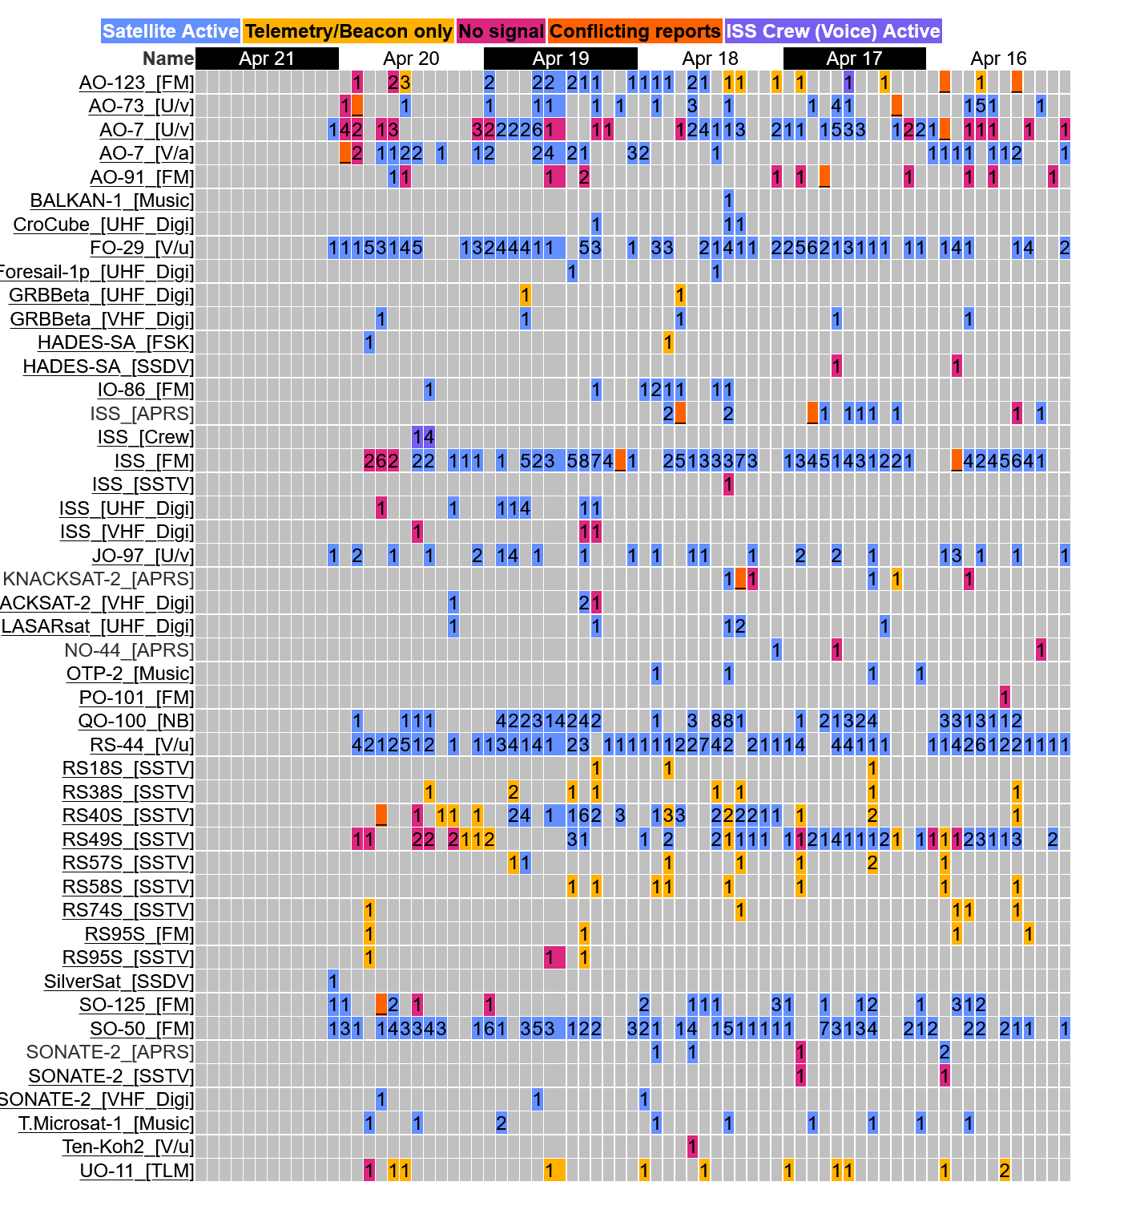
Step-by-Step Operating
Check the status of the satellite - https://www.amsat.org/status/

Slide 15
Step-by-Step Operating
Program radio memories
Channel # | Name | TX Freq | TX Tone | RX Freq
101 | ISS-1 | 145.990 | 67.0 | 437.815
102 | ISS-2 | 145.990 | 67.0 | 437.810
103 | ISS-3 | 145.990 | 67.0 | 437.805
104 | ISS-4 | 145.990 | 67.0 | 437.800
105 | ISS-5 | 145.990 | 67.0 | 437.795
106 | ISS-6 | 145.990 | 67.0 | 437.790
107 | ISS-7 | 145.990 | 67.0 | 437.785
Make it easy and use CHIRP or RT Systems programmers to manage memory channels on your radio(s)

Slide 16
Step-by-Step Operating
Listen First !
Open your squelch – usually a menu setting in the HT
Antenna attached to radio(s)
Use a smartphone – Voice Memo (iOS), Voice Recorder (Android), Mideo. Can record while running another app e.g. your tracking app. It is on right !?
Know where to point your antenna e.g. NW in this case
Adjust for Doppler – start high in receive frequency

Slide 17
Step-by-Step Operating
How to make a call
  Do NOT call CQ on FM ‘birds’ !
  Listen for a strong station e.g. W4ABC
  Once he is free, call W4ABC, Kilo Four Romeo Foxtrot Tango, Echo Mike 56
  Remember, he knows his call – use phonetics only on your call & grid
  He may return: K4RFT, Echo Lima 94, QSL ?
  Finish with YOUR call: K4RFT QSL Thanks !
Remember to keep tracking with your antenna – rotate your wrist to adjust polarity for the strongest signal
FM ‘birds’ are busy so NO rag-chewing

Slide 18
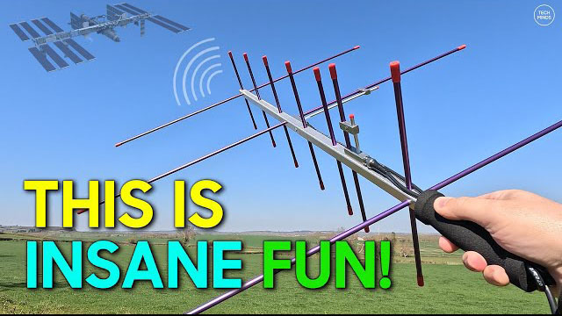
Step-by-Step Operating
Congratulations ! You’ve made your first satellite contact. Quite an experience indeed ! Now go put the QSO in your log and send it up to LOTW

Slide 19
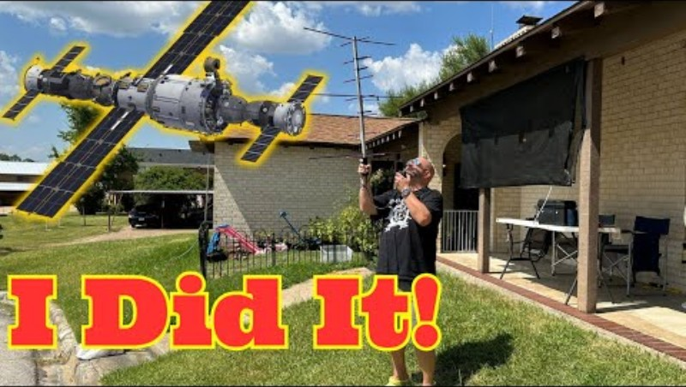
Mike K8MRD First Sat Contact

